Slide 1
Land Acknowledgment
I would like to acknowledge the Wurundjeri people who are the Traditional Custodians of this Land. I would also like to pay respect to the Elders both past and present of the Kulin Nation and extend that respect to other Indigenous Australians present.
Notes:
https://margaretprice.wordpress.com/access-statement-for-presentations/

Slide 2
Access statement
Please feel free to use this space however is accessible to you during this presentation/conversation. Stand up, move around, stretch, lie down, or make use of this space however feels right to you. (If you knit, go for it!)

Slide 3
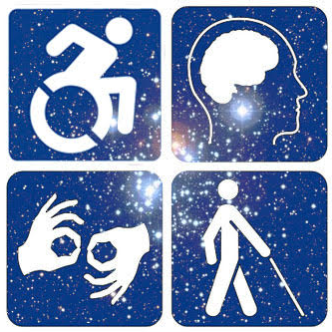
Inclusive Astronomy is Accessible Astronomy
Alicia Aarnio
Assistant Professor, University of North Carolina Greensboro
Co-Chair, AAS Working Group on Accessibility and Disability
Co-Chair, AAS Site Visit Oversight Committee
@AliciaAarnio @AAS_WGAD http://wgad.aas.org These slides: bit.ly/aa_140819
Notes:
The website is going to change soon, the AAS is redesigning everything… it will be aas.org/wgad after the change

Slide 4
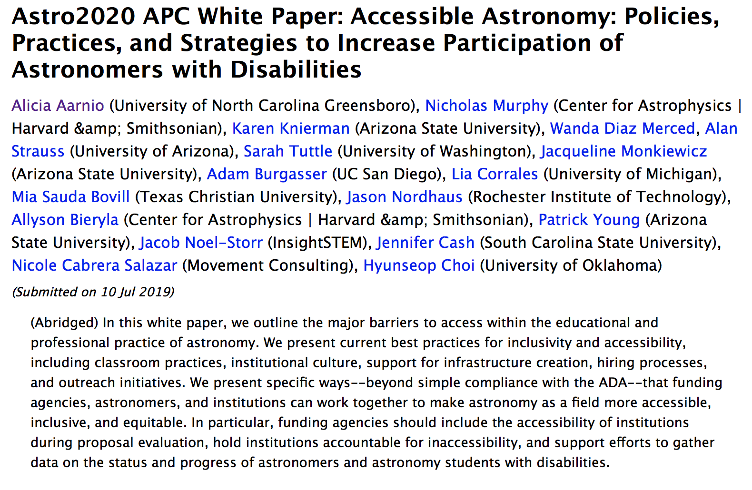
Astro2020 state of the profession white paper
https://arxiv.org/abs/1907.04943

Slide 5
Definitions
Disability: “A physical or mental impairment that substantially limits one or more major life activities; someone who is disabled is regarded as having such an impairment and has a record of the impairment”
Ableism: discrimination in favor of able-bodied or neuro-typical people
Common models of disability:
Medical model: impairment is aberration, deviating from the norms. Something to be “cured”
Social model: disablement only occurs when non-normative body/mind encounters barriers due to structures designed for able/neurotypical
Nordic model: removing barriers is absolutely necessary, but we must recognize that it won’t equalize experience of people with disabilities; must still consider impact of individual’s impairment

Slide 6
Disability and identity
Disability is an axis of our identities on which we move throughout our lives
In an intersectional analysis of minoritized identities, we recognize the compounded disadvantage experienced by astronomers with multiple marginalized identities
Many, despite meeting federal criteria for disability designation, prefer to not identify as disabled

Slide 7
Disclosure and stigma
Disability is stigmatized.
In US industry workplace surveys, almost 1/3 of respondents fit at least one federal criterion for having a disability. Single-digit percentages willing to actually disclose this or ask for accommodations
In academia, our minds are our currency and credibility: neuroatypicality or mental illness carry additional stigma
In academia, we are judged by comparison to unrealistic models of productivity. These are additionally unrealistic for astronomers with disabilities
Academic environments tend to exacerbate mental illness
Do not expect someone with a disability to be willing to tell you, however kind of a person you may be!
Notes:
Universal design automatically includes accommodation for many disabilities, and access tools generally help everyone.

Slide 8
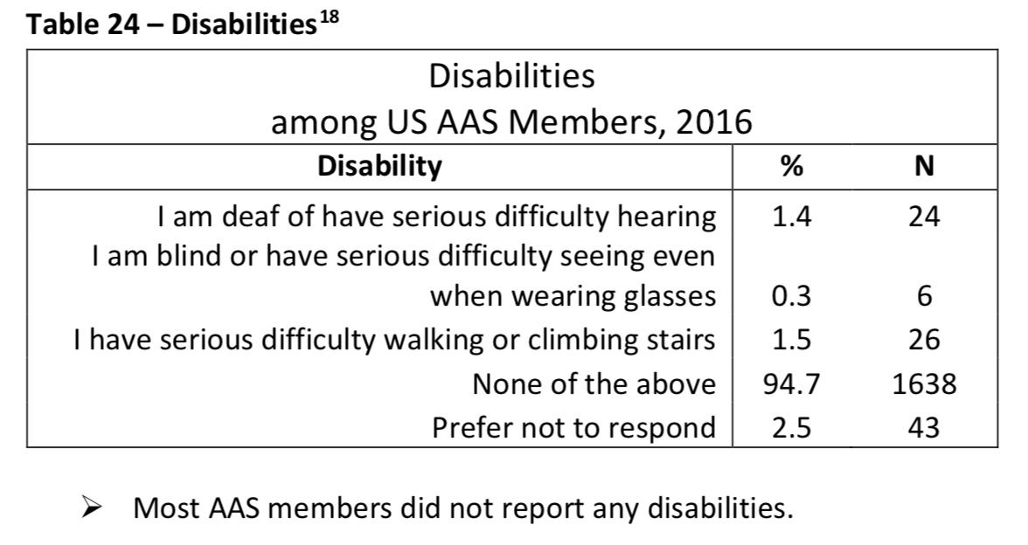
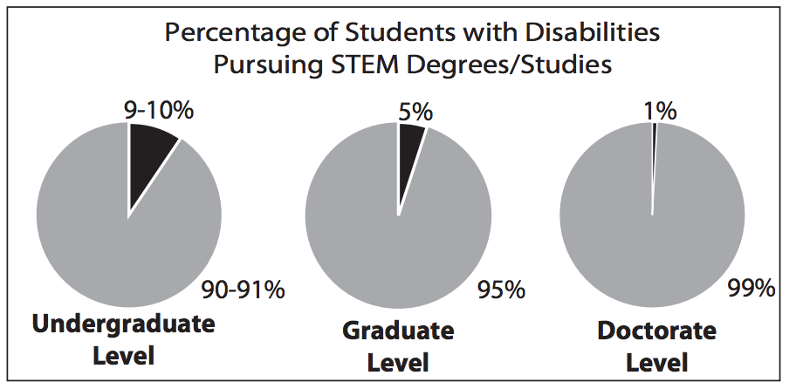
Dismal statistics
There are actually so few data, entire projects exist that largely document a lack of data (the Zero Project)
As it stands right now, there isn't even enough value placed on people with disabilities to adequately survey to determine participation, quality of experience, or the extent of our losses due to inaccessibility
Message: we are not even worth counting.
Notes:
We’re working with the aas demographics team/AIP to add more options to the survey.
https://hourofcode.com/files/accommodating-students-with-disabilities.pdf
https://aas.org/files/aas_members_workforce_survey.pdf

Slide 9
Disability in Australia
1 in 5 Australians identifies as disabled
Working-age disabled Australians have lower rates of participation (54%) than able Australians (83%), and almost double the unemployment rate (4.9% vs 9.4%)
Disability discrimination is the top reason for reports filed to Australian Human Rights Commission
ASA/IDEA, as far as I can tell, have only surveyed membership re: gender identity
Notes:
https://www.and.org.au/pages/disability-statistics.html
https://asa-idea.org/statistics/
Inclusion, Diversity, and Equity in Astronomy chapter of the Astronomical Society of Australia

Slide 10
What we’re doing
Active work by the AAS Working Group on Accessibility and Disability (WGAD)
Publications: working with AAS Publishing and IOP Publishing on
external accessibility audits of their websites, submission structures, and back-end design
recommendations for authors, referees, and editors
Databases: in discussion with ADS, Simbad, ViZier designers to make interfaces accessible
Meetings: preparing recommendations for the AAS to implement at AAS full, division, and topical content series meetings
Raising awareness: will be presenting a town hall at the AAS 235th meeting in Hawaii, January 2020, to highlight barriers faced by disabled astronomers and fundamental inequity of experience

Slide 11
What everyone can do
Generally:
Build intersectional coalitions
Acknowledge and talk about differences
Teach disability+/astronomy history (e.g., Annie Jump Cannon, Henrietta Leavitt, George Hale)
Support shared spaces
Reject the pathology paradigm (“there is one normal, disability is a defect”)
Affirm different ways of being
Recognize disability

Slide 12

What everyone can do
Specifically:
Develop content using universal design principles
Alt-text
High contrast color schemes
Use accessible file formats, provide original documents for users to be able to manipulate
On posters, can use QR codes to link user to (accessible) powerpoint, text files, or recorded reading of poster elements
Provide information in multiple ways (multimodal access)
Sonify data
Plot, visualize, render
3D print
Notes:
https://www.thingiverse.com/thing:1740115
Here, I’m showing 4 different ways to present the same idea. This is multimodal access. Increasing modes increases likelihood the idea will resonate with more in the audience.

Slide 13
What everyone can do
English is vast and flexible, avoid ableist language
“Blind” refereeing/review (equates blindness with ignorance/not knowing)
“Crazy” results, “insane” observations, “lame” behavior, “spaz,” the “R” word, “psychopath,” “sociopath”
Author publications with accessibility in mind
Clear descriptions
Straightforward navigation/useful section headings
Accessible color palettes (ColorOracle)
Large graphical elements in figures
Descriptive captions
Ensure facilities and activities are accessible
Inaccessible: Arxiv running group discussion
Accessible: paper discussions in accessible lounge/conference room space
Invite an external site visit to assess building/observatory/facility accessibility
Notes:
http://deareverybody.hollandbloorview.ca/resources/tips-and-tools/how-to-avoid-using-ableist-language/

Slide 14
What everyone can do
At meetings:
Use the microphone, always; insist everyone does
Respect designated low vision/hard of hearing seats
Request food ingredient labels, even if you don’t personally need them
Provide quick links/codes to accessible formats of your presentation (as embargo allows!)
By default, provide accessibility and accommodation information on syllabi, job listings and in any visitor information/invitations to external guests
Value inclusion work. Hold it in comparable regard to scientific progress, since science itself depends on having people to do it.
Notes:
http://deareverybody.hollandbloorview.ca/resources/tips-and-tools/how-to-avoid-using-ableist-language/

Slide 15
To be a truly inclusive field, we must acknowledge disability and neuroatypicality, confront exclusionary barriers to access, remove stigma, and make astronomy accessible.
These changes benefit all. If we build it [an inclusive field], they will come.

Slide 16
Additional information
wgad.aas.org
All of WGAD’s recommendations and publications
Resources page
Contact information for the working group
Our google group email list: AccessAstronomy
Twitter: @AAS_WGAD
accessastronomy.blogspot.com
International partnerships: IAU Commission C-1 Working Group: Astronomy for Equity, Inclusion and Diversity
Upcoming meetings:
Inclusive Astronomy 2, Baltimore MD USA, October 14+15
IAUS 358, “Astronomy for Equity, Diversity and Inclusion — a roadmap to action within the framework of the IAU 100th Anniversary,” Tokyo Japan, Nov 12-15
Notes:
https://www.iau.org/science/scientific_bodies/commissions/C1/
https://outerspace.stsci.edu/display/IA2

